Slide 1
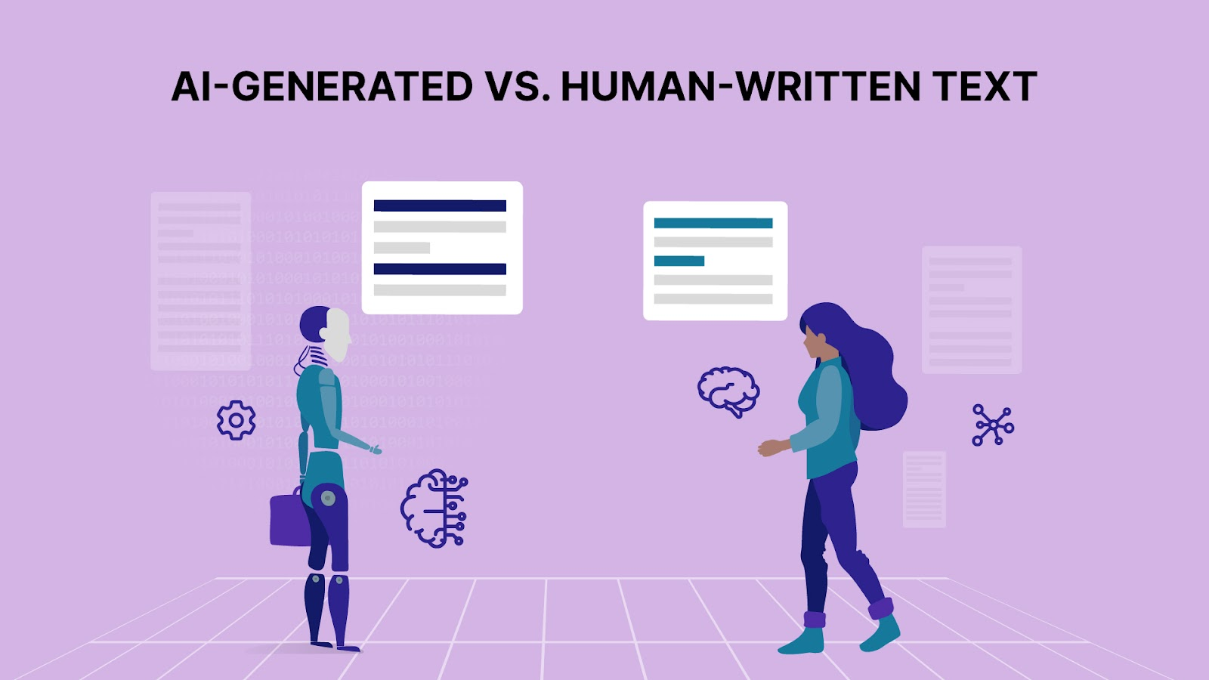
Human vs AI Text Classification
Prepared By: Muhammad Osama

Slide 2
Dataset
Human vs AI Text Classification
5000 samples (2500 Human, 2500 AI)
2 columns: text, label
Balanced dataset (equal samples per class)
Labels: 0 = Human, 1 = AI
Source: Kaggle

Slide 3
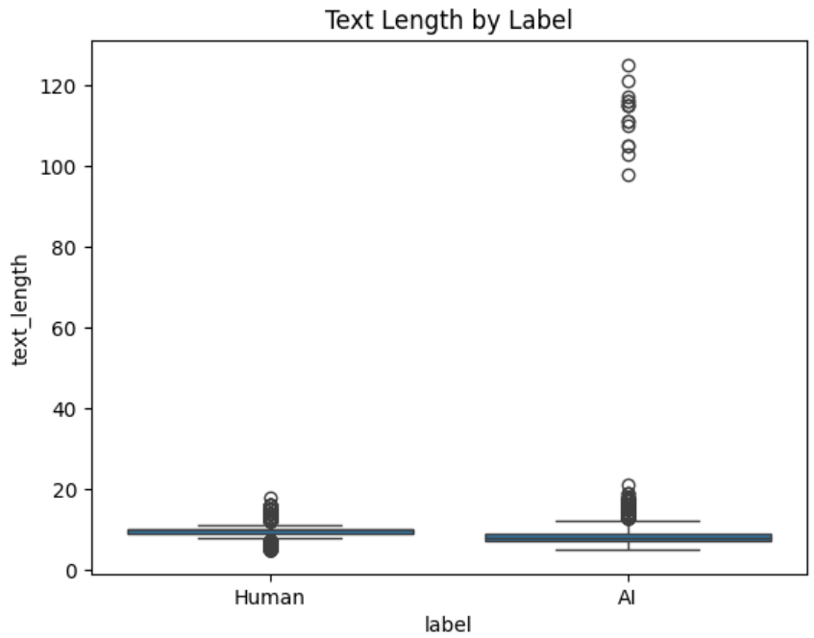
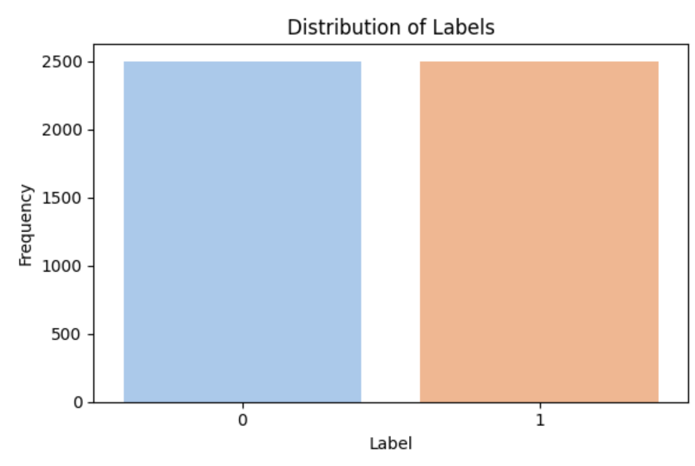
Exploratory Data Analysis (EDA)
Label Distribution: Balanced classes
Word Cloud: Frequently used words
Text Length: AI texts show more extreme outliers

Slide 4
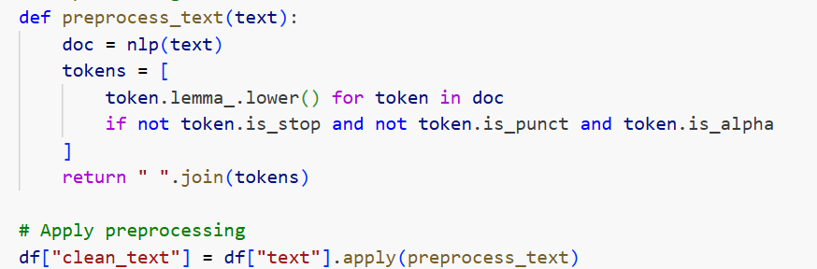
Preprocessing with SpaCy
Lemmatization (root word conversion)
Lowercasing text
Removing Stopwords & Punctuation
Created new column: clean_text

Slide 5
Model 1 – SpaCy TextCategorizer
Neural text classification model
Captures semantic & contextual patterns
Hyperparameters tuned: width (64,128), dropout (0.3,0.5)
Trained for 5 epochs per config

Slide 6
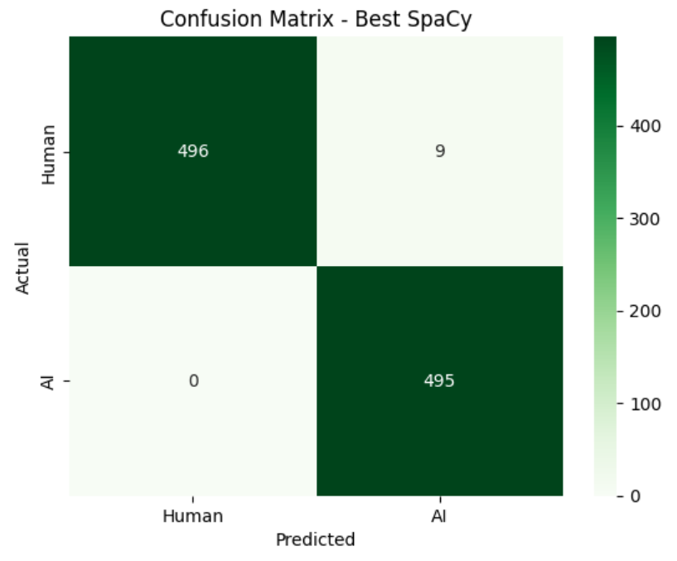
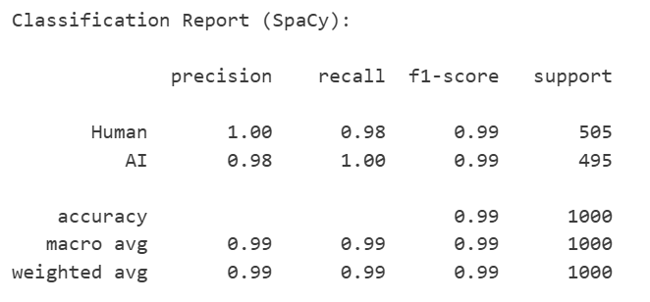
Model 1 – SpaCy TextCategorizer

Slide 7
Model 2 – RandomForestClassifier
Classical ML model
Uses bag-of-words features via CountVectorizer
Hyperparameters tuned: n_estimators (100,200), max_depth (10,20)
Trains fast and interpretable

Slide 8
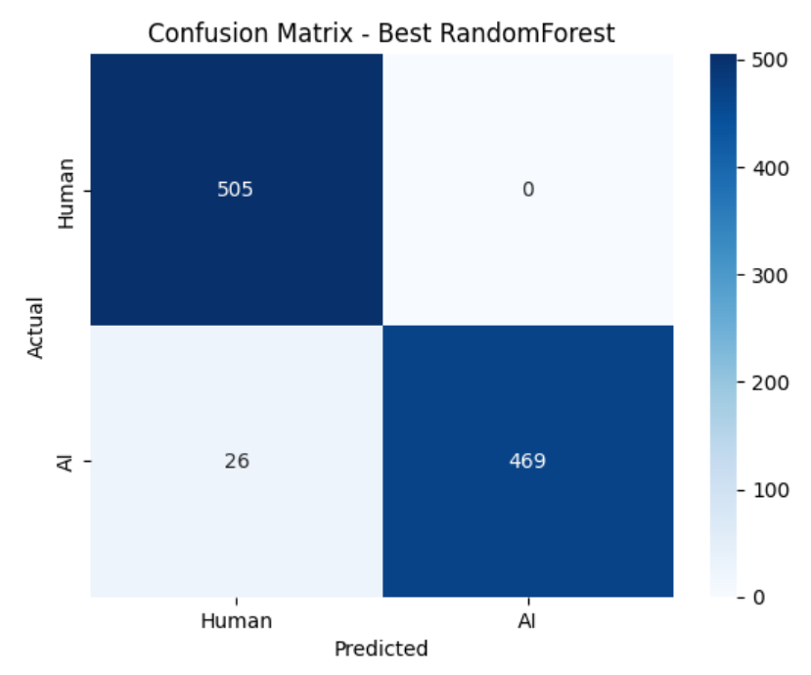
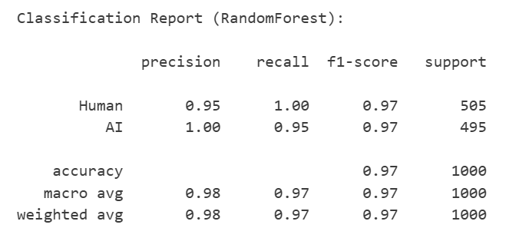
Model 2 – RandomForestClassifier

Slide 9
Hyperparameter Tuning & Results
SpaCy: Best → width=64, dropout=0.5 → F1=0.9920
RandomForest: Best → n_estimators=200, max_depth=20 → F1=0.9730
Balancing capacity (width/depth) & regularization (dropout) is key

Slide 10
Model Comparison
SpaCy: Accuracy=99.1%, Recall=100%, F1=0.9920
RandomForest: Accuracy=97.4%, Precision=100%, F1=0.9730
Conclusion: SpaCy slightly better, RF still reliable

Slide 11
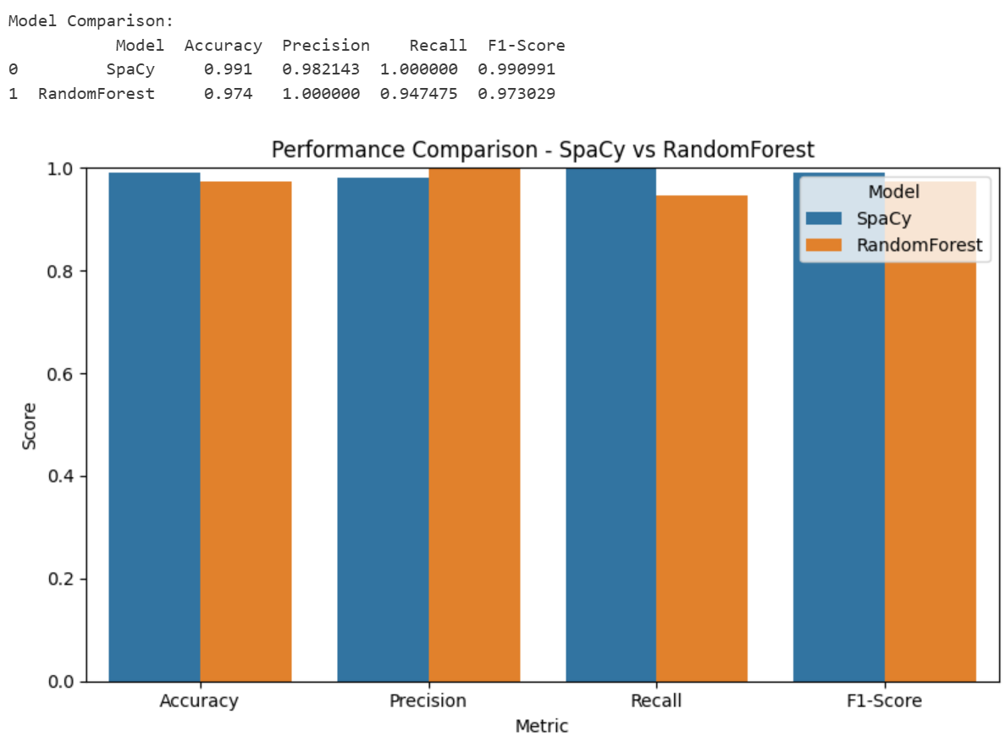
Model Comparison

Slide 12
Strengths of SpaCy vs RandomForest
SpaCy: Captures semantics & context, better for longer texts, high recall
RandomForest: Fast training, easy interpretation, strong precision

Slide 13
Thank you

